Slide 1

Capstone Project-2
Seoul Bike Sharing Demand Prediction
-Team members
Babu
Manoj
Aman

Slide 2
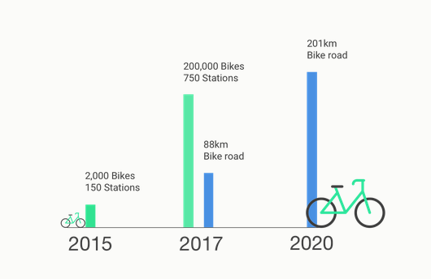
The Bike Sharing Analysis follows :
Problem Statements
Data Information
Analysis of Data
Data Cleaning/ Imputation
Data Preparation
Model Training
Evaluation Metrics
Challenges
Conclusion

Slide 3
Problem Statements
What can we learn from predictions? (ex: Days, Temperature, seasons,etc).
Prediction of bike count required at each hour for the stable supply of rental bikes.
Highest Booking counts in Season, Month and Week.
Finding Variations in data
Finding the best estimating algorithm

Slide 4
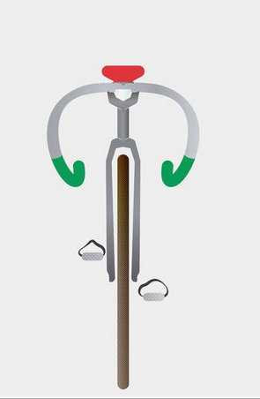
Data summary
Dataset file : Seoulbikedata.CSV file from Dec2017 to Jan2018
Shape:
Columns:14
Rows:8760
Important Columns and Units
Date
Rented Bike Count
Hour 24units
Temperature (°C)
Humidity (%)
Wind speed (m/s)
Visibility (10m)
Solar Radiation (MJ/m2)
Seasons
Holidays
Functioning Day

Slide 5
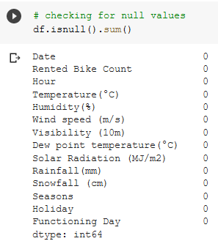
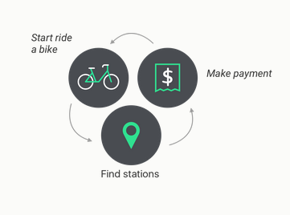
Data Cleaning and imputation
Checking for Duplication in Data frame columns.
Checking for Nan/Null Values.

Slide 6
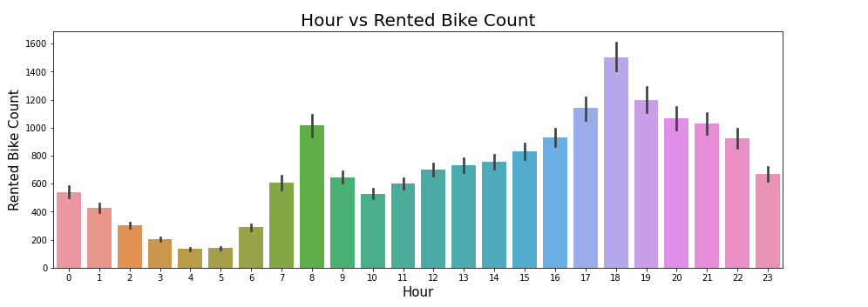
What time in a day is highest bike rented?

Slide 7
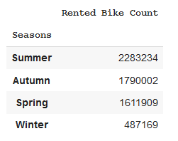
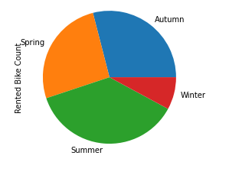
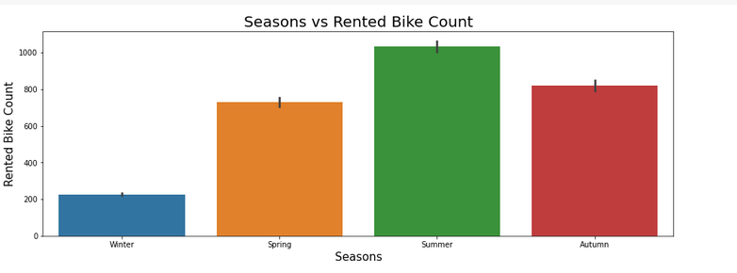
Which Season has most bike Rents?

Slide 8
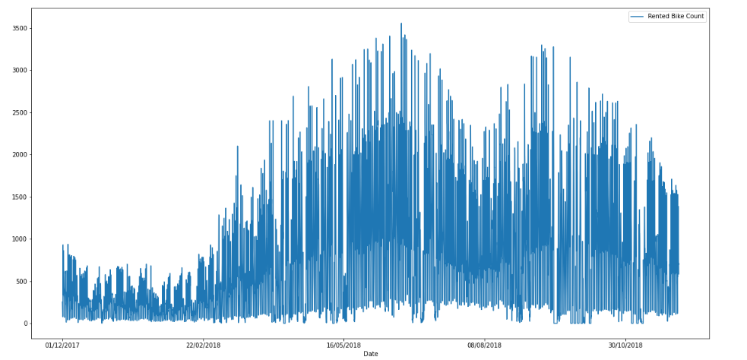
Which Date in a month has highest booking count?

Slide 9
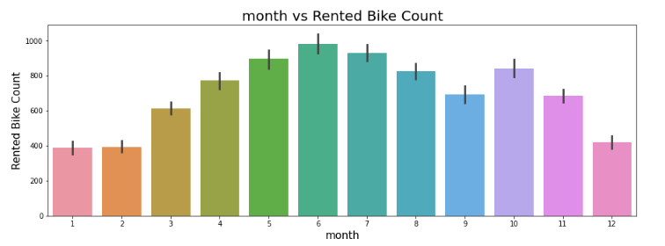
Which Month has highest booking count?

Slide 10
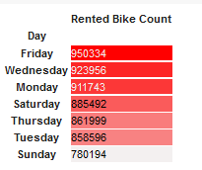
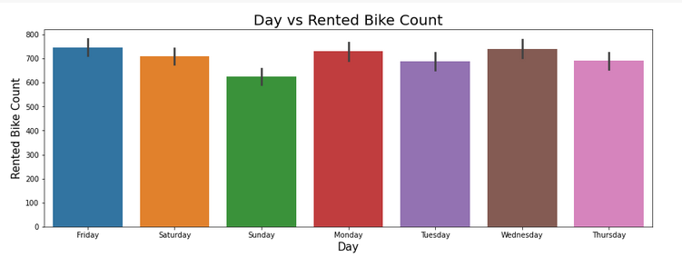
Which day in a week has highest booking?

Slide 11
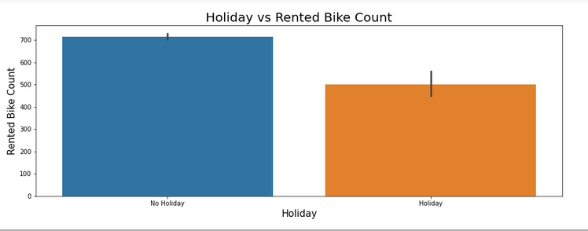
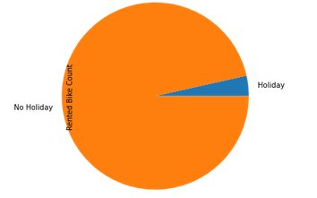
Is there any bookings on Holiday?

Slide 12
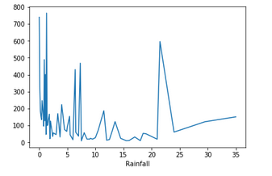
Is there any Variations in Rainfall(mm) Data?

Slide 13
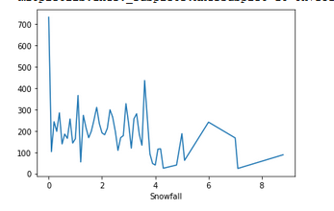
Is there any Variations in Snowfall(cm) Data?

Slide 14
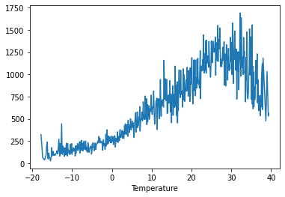
Line plot of Temperature vs Rented bike count

Slide 15
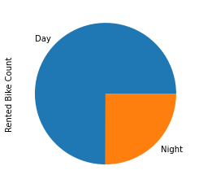
Pie chart of Rental bikes count during Day and Night

Slide 16
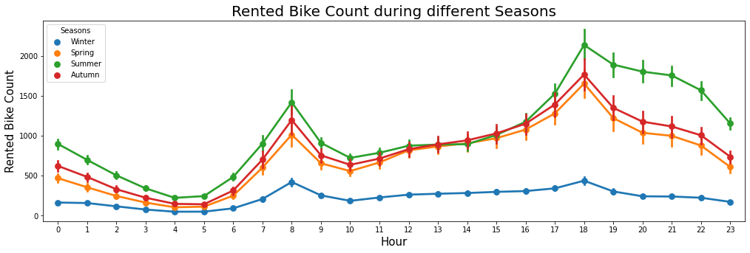
Rented bike Count During Different Seasons

Slide 17
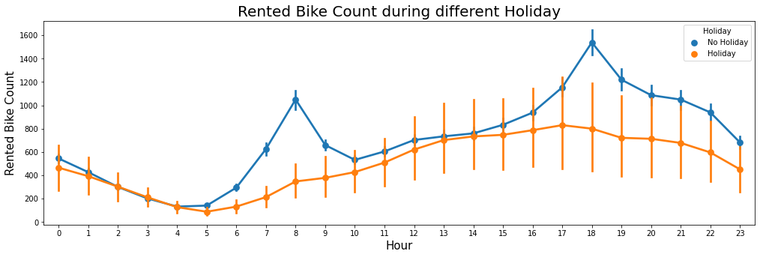

Slide 18
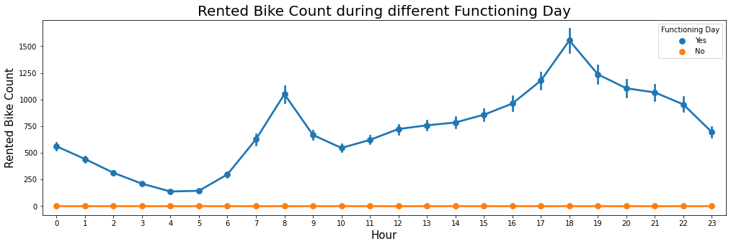

Slide 19
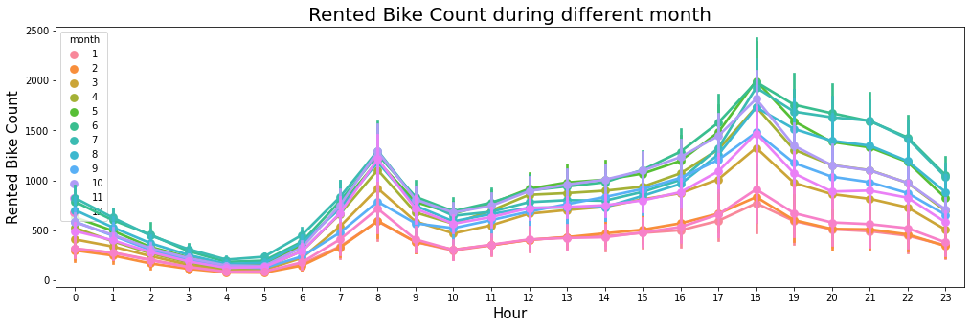

Slide 20
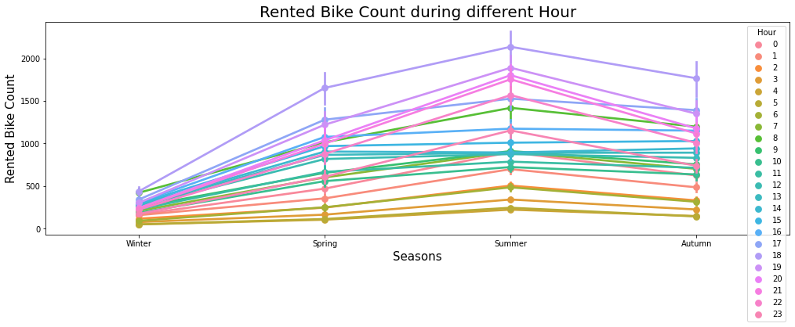

Slide 21
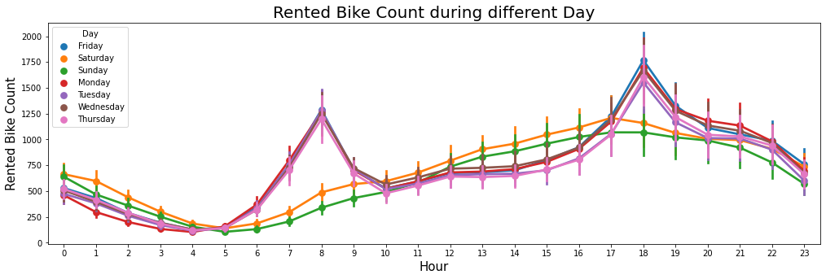

Slide 22
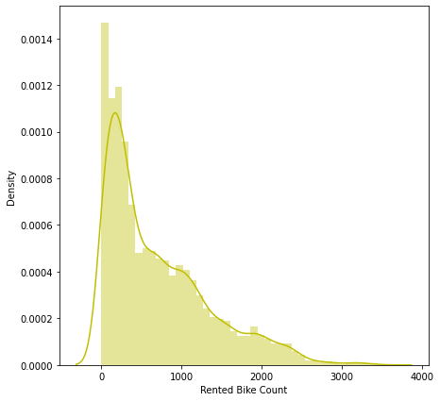
Distribution Plot of Bikes taken for rental

Slide 23
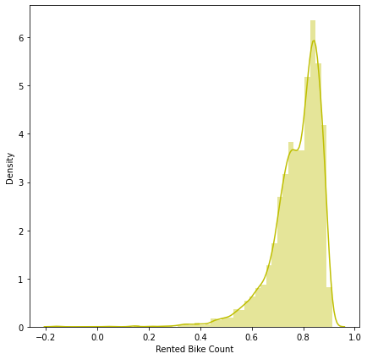
Distribution of Bikes taken for rental after applying log transformation

Slide 24
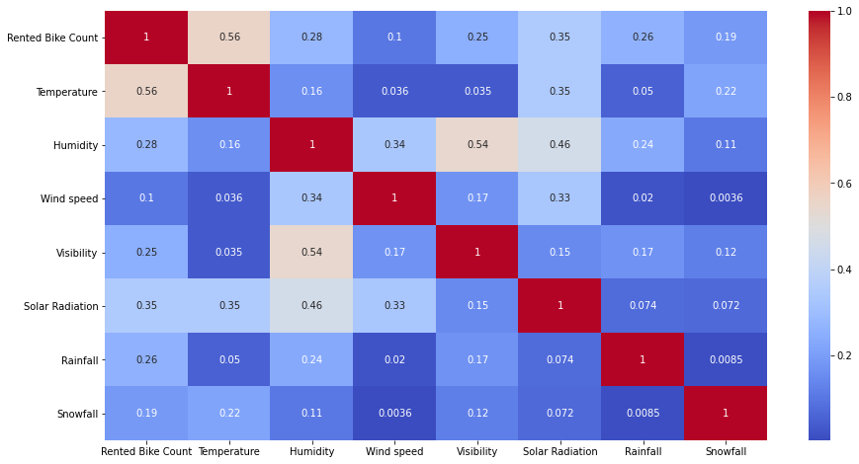
Heatmap

Slide 25
CONVERT THE DATASET INTO THE DEPENDENT AND THE INDEPENDENT VARIABLE
Independent Variable (X): Temperature , Humidity , Wind speed , Visibility , Solar, Holiday , Functioning Day , hour_1 , hour_2 , hour_3 , hour_4 , hour_5 , hour_6 , hour_7 , hour_8 , hour_9 , hour_10 ,hour_11 , hour_12 , hour_13 , hour_14 , hour_15 , hour_16 , hour_17 , hour_18 , hour_19 , hour_20 , hour_21 , hour_22 , hour_23 , season_Spring , season Summer ,season Winter , month_2 , month_3 , month_4 , month_5 , month_6 , month_7 , monthweekDay_4 , weekDay_5 , month_8 , month_9 , month_10 , month_11 , month_12 , weekDay_2 , weekDay_3 , weekDay_4 ,weekDay_5 , weekDay_6, weekDay_7
Dependent Variable (Y): Rented Bike Count'
SPLIT THE DATA INTO TRAINING SET AND THE TEST SET
from sklearn.model_selection import train_test_split
X_train, X_test, y_train, y_test = train_test_split( X,Y, test_size = 0.2, random_state = 0)
print(X_train.shape)
print(X_test.shape)

Slide 26
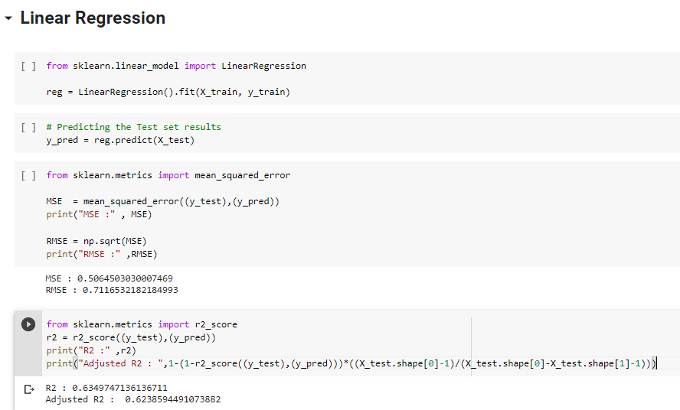

Slide 27
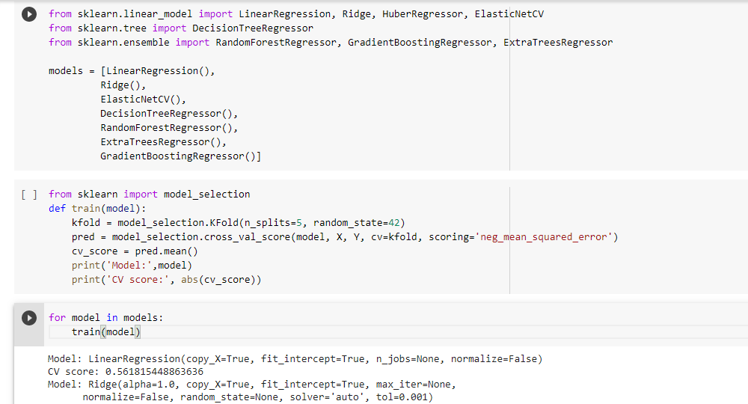

Slide 28
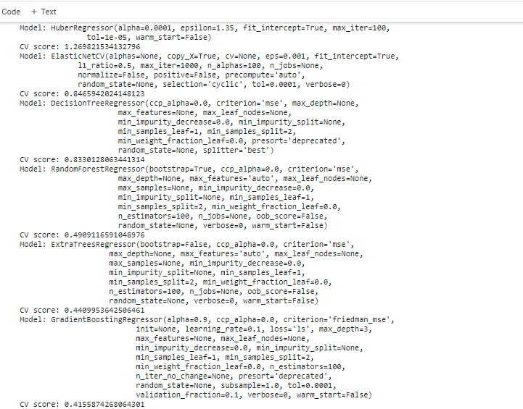

Slide 29
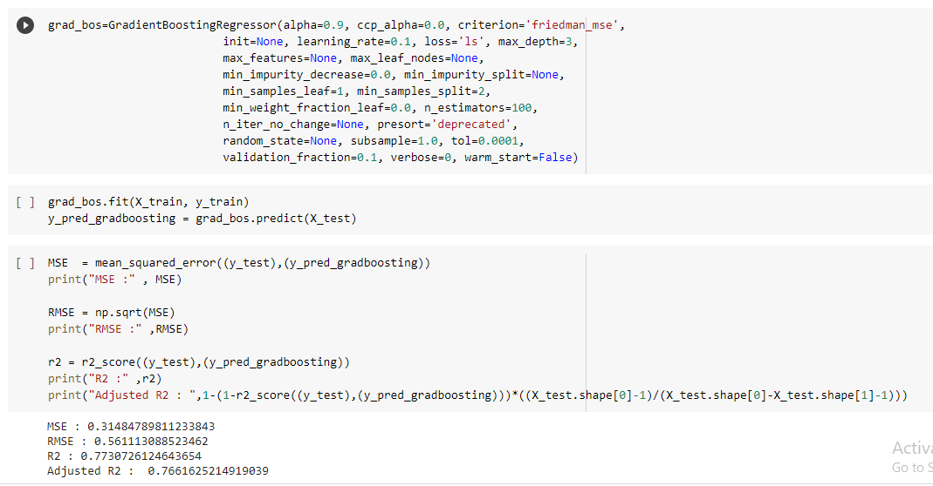
Gradient Boosting Algorithm:

Slide 30
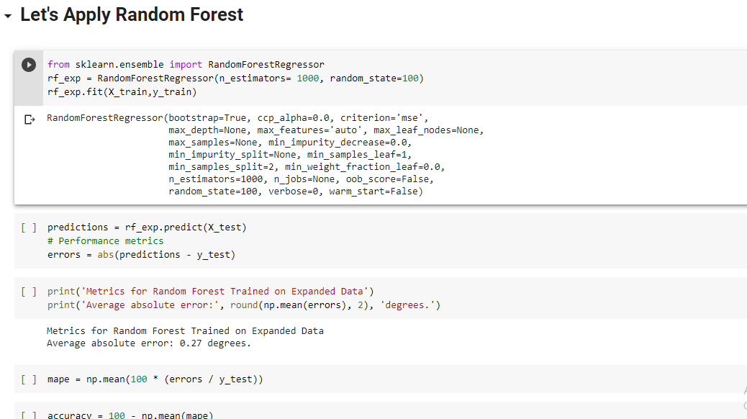

Slide 31
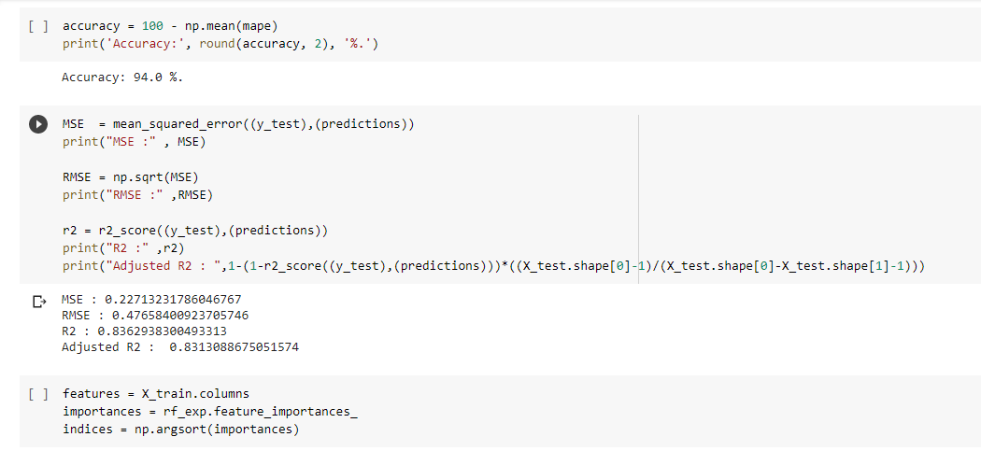
Accuracy: 94.0% MSE : 0.2271 RMSE: 0.4765
R2: : 0.8362 Adjusted R2: 0.8313

Slide 32
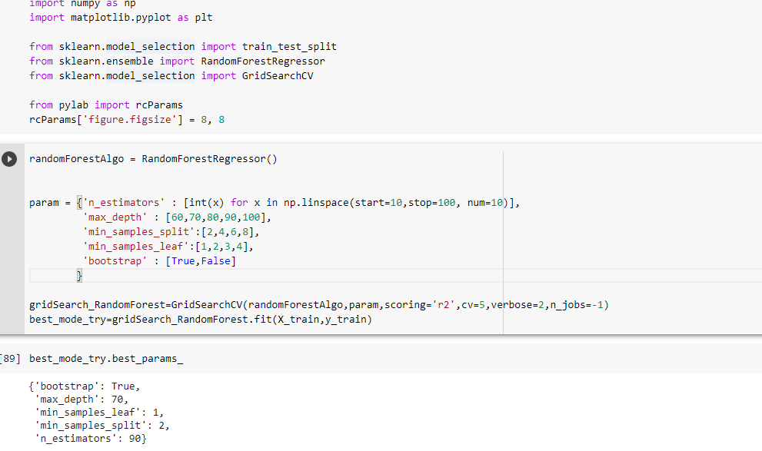
Random Forest with some Parameter

Slide 33
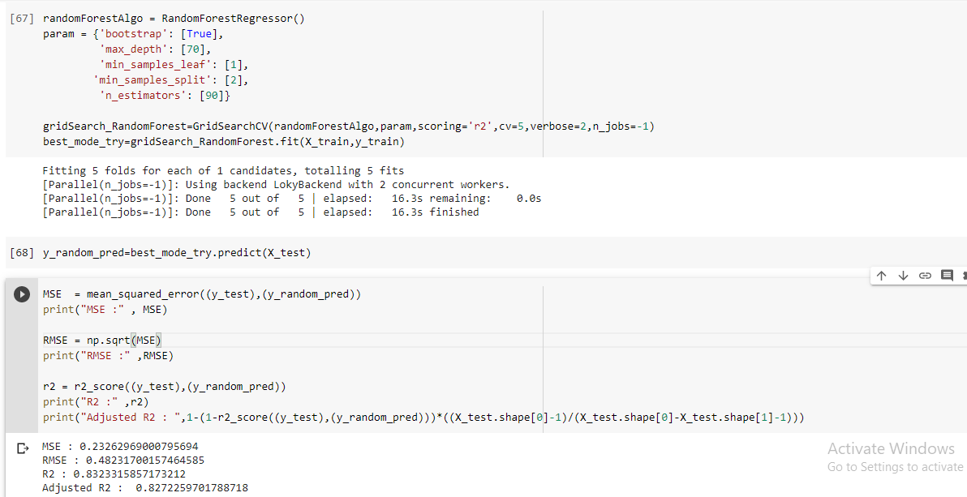
MSE: 0.2326 R2: 0.8323
RMSE: 0.4823 Adjusted R2: 0.82722

Slide 34
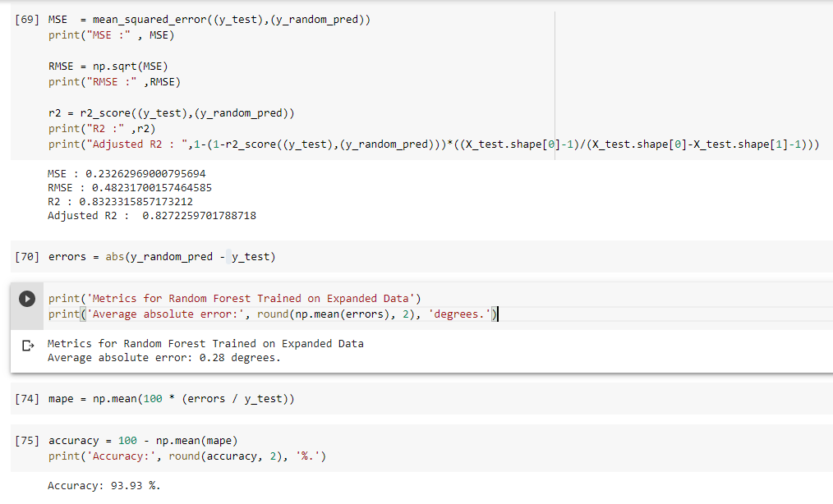
Accuracy: 93.93 %

Slide 35
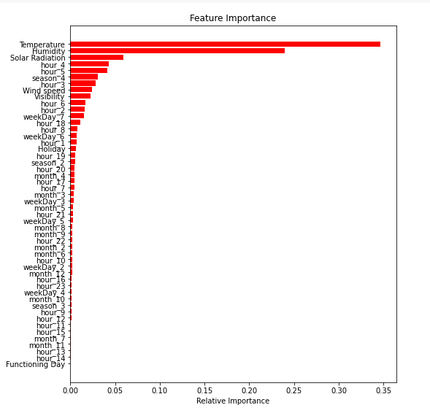

Slide 36
Conclusion
People like to ride bikes when it is pretty hot around 25°C in average
In morning hours(8-9) and in evening hours (5-8),the bikes taken for rental are more .
So let's focus on the seasons where we have the most rents because at the
month of may (5) to july (7) bikes have the most rents.
Bikes taken for rental are more in Summer and less in Winter
Here we see at the weekend Bike goes to be rented less compare to the
working days.
During No Holidays , the bikes taken for rental are more than
during holidays.
Bikes for rental are very high during functioning days.
Number of Bike Rented in day is high as compare to the night
During Summer ,rented bikes are more in each hour than other seasons
During Winter ,rented bikes are less in each hour compared to other
seasons.
We see the Rainfall so most of the value is 0.0 and but some of the value
we can say that people enjoyed ride with bike during rainfall.
When snowfall more than 4 cm of snow, the bike rents is much lower

Slide 37
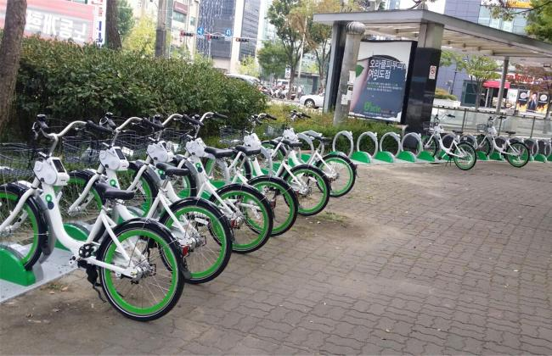
Conclusion
At Saturday and Sunday we see the Bike rented is less but at the evening
time it goes bit up.
Monday to friday all the hours seems like same for the Rented Bike
count.
Used many of the algorithm t check for the best predicted results but
Random Forest model looks better as compare to the other model.

Slide 38


Slide 39
THANK YOU

